Slide 1
Random Agent:
Training a Robotic Hand in Object Orientation Tasks
A research by: Amir Pliev, Raphael Fortunato, Mike Nies and Julio Goodsaid

Slide 2
Random Agent:
Content
Reinforcement Learning
Deep Deterministic Policy Gradient
Hindsight and Prioritized Experience Replay
Results
Conclusion

Slide 3
Random Agent:
OpenAI Gym
Reinforcement learning playground
Provides multiple environments to train agents
Agents can (most of the times) be transferred to other similar environments

Slide 4
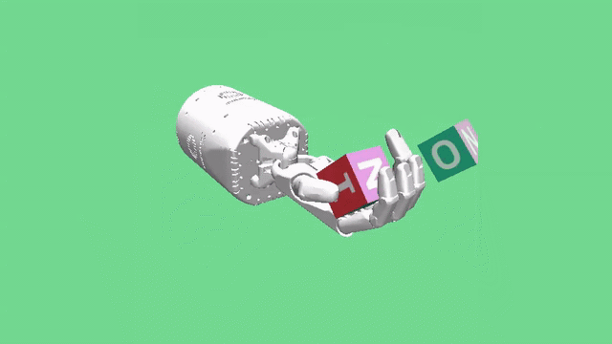
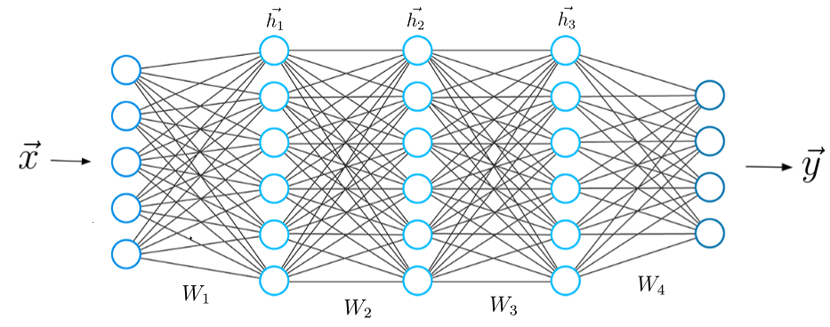
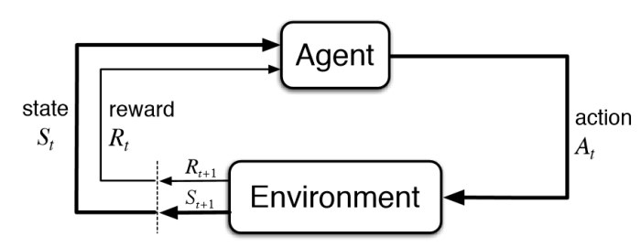
Begin learning:
Deep Reinforcement Learning
Positive and negative reinforcement
Exploration happens through randomness
Uses Neural Network as function approximator

Slide 5
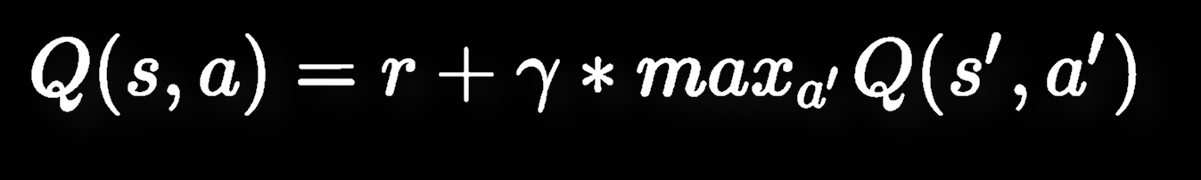
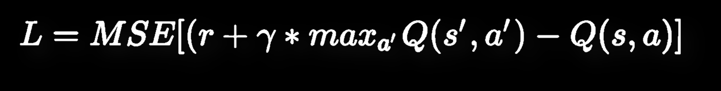
Becomes better
Bellman Equation
Agent improves by minimizing the MSE loss of the bellman equation

Slide 6
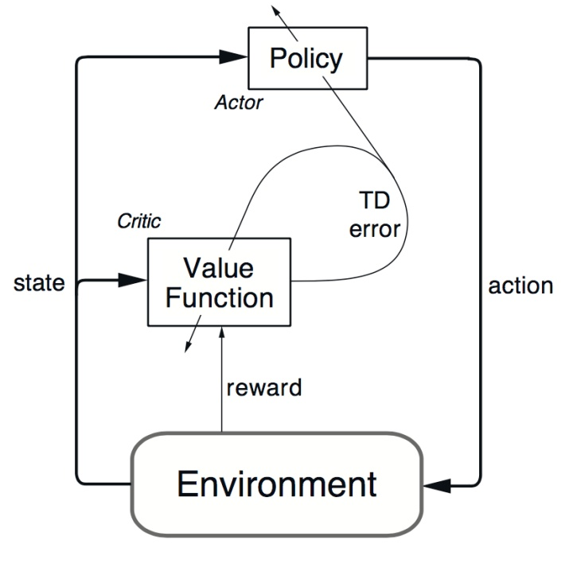
Intermediate:
DDPG
(Deep Deterministic Policy Gradient)
Actor and Critic cooperation
Select the best action to perform in a given state
The critic network is tasked with finding the proper Q-value for a given state action pair.

Slide 7
Advanced learner:
HER and PER
Hindsight Experience Replay (HER)
Achieved goal becomes actual goal
Future-k variation
Learning from negative experiences
Prioritized Experience Replay (PER)
Prioritize “important” experiences
Hopefully also speeds up the learning process
Our variation:
Focus on Distance metric
Focus on Impact metric
70% in sample is ‘important’

Slide 8
Final stages
Parameters
Network layers
3 layers with 256 units and ReLU
Epochs = 90
Future-k = 4
Probability of HER = 0,8
Distribution of PER = 0,7

Slide 9
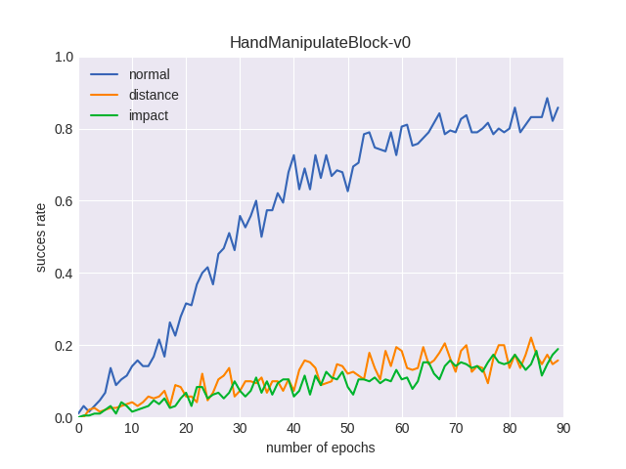
Master:
Results
Final demo
Normal HER outperformed our version of PER
PER seems to not process all states

Slide 10
Timelapse
Conclusion
Distance and Impact did not increase training efficiency
Metrics do not capture essential states making agent unfamiliar to many
Future Research: Implementation of PER using another metric (TDE)

Slide 11
Questions?
Timelapse

